Slide 1
Theories and Evidence

Slide 2
By the end of this lesson, you should be able to:
• | Recognise the relationship between theories, hypotheses and evidence.
• | Describe the types of evidence for the theory of evolution.

Slide 3

Evidence is information that is gained through observing an event or conducting an experiment.
It is often used to support or reject a hypothesis.

Slide 4
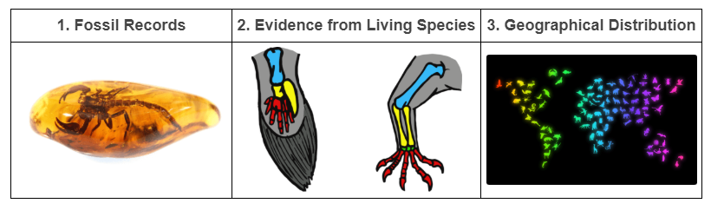
Evolution is a theory that has a lot of different evidence to support it!
The most important pieces of evidence are:

Slide 5
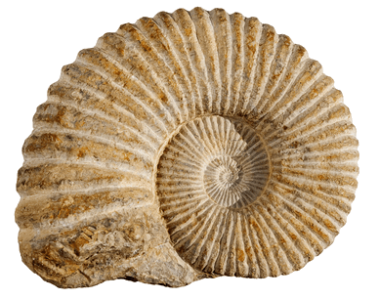
Fossils are the preserved evidence of the existence of past organisms, and they are often thousands or millions of years old!
The fossil evidence can be the whole or part of an organism's body, or evidence that the organism was active in a particular area, such as their tracks, burrows, or faeces (bodily waste).

Slide 6
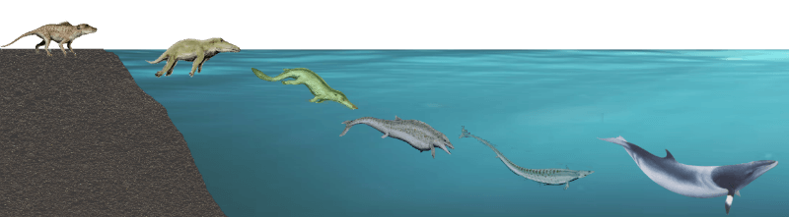
A fossil record is a list of all the organisms that fossil evidence has been found for.
Some species have a more complete fossil record than others, with more fossil evidence having been discovered. This can be for a specific species, or as a measure of the history of life on Earth.
The fossil record provides us with evidence that species have changed over time, both in their structure and in their activities. It can be thought of as a timeline of the evolution of a single species, or of all the species on Earth.

Slide 7
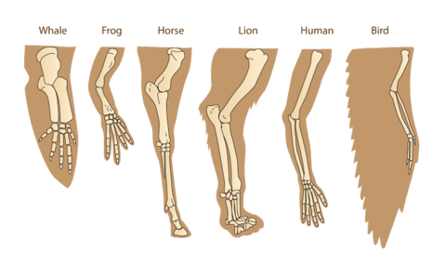
A lot of evidence for evolution can be found just by looking at the living species in the world today!
The structures of living species can be compared to each other or those of fossils to determine how they may be related. This is known as comparative anatomy.
It is known as comparative anatomy because we compare the anatomy (bodily structures) of different organisms to each other to look for similarities and differences.

Slide 8
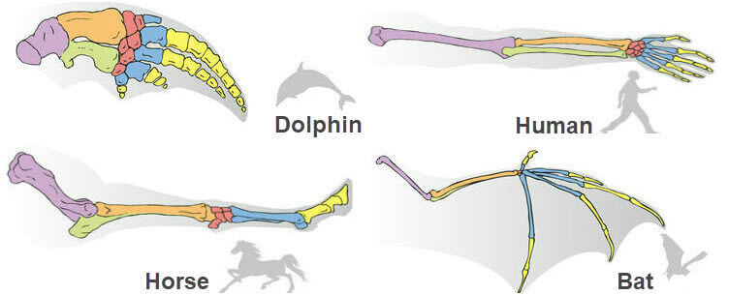
Homologous structures are body parts with the same basic formation in different species, but with different functions.
If two species have homologous structures, it suggests they could have inherited it from a common ancestor, and therefore be related.

Slide 9
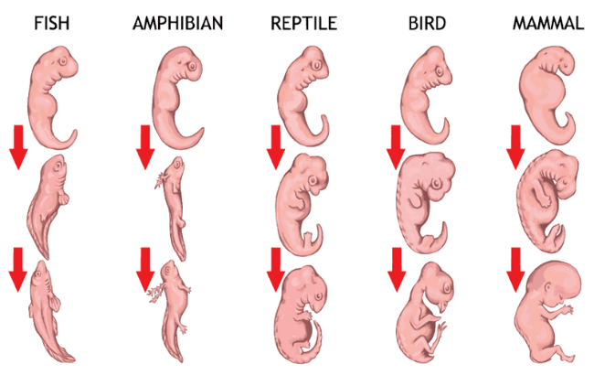
Comparing the embryology and DNA of different species can also give us an idea of how they may be related!

Slide 10
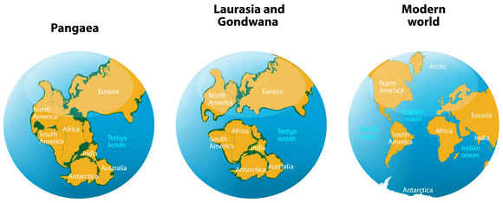
Geographical distribution, or biogeography attempts to explain where species occur while taking into account factors such as climate, sea-level change and tectonic plate movement.

Slide 11
The geographical distribution of species provides evidence for evolution by demonstrating what happens when populations of a species are separated geographically, for instance when a continent divides.
The new environment causes the isolated population to adapt and, without interbreeding with the original population, the isolated population can change and become a new species.

